Slide 1
Simulating Traffic
Jacob Rozran
MAT 7500 – Statistical Programming

Slide 2
The Problem
Many traffic lights are stupid
The operate on timers with limited ability to change behavior
Examples of the stupid lights:
Sitting at a red light when no one is coming in any other direction
Waiting in gridlocked traffic due to lights being greenlighted in the wrong direction

Slide 3
The Simulation Set-Up
One mile stretch of road
Traffic light at the ¾ mile mark
No cars on the road to begin
Cars must maintain 2 second cushion
35 mph speed-limit on this road
Each iteration represents one second
Each simulation lasts for one hour (3600 seconds/iterations)

Slide 4
The Simulation
Step 1: Can a car be added?
If there is enough padding (2 seconds), try to add a car
Step 2: Is a car added?
Take a random sample from a uniform distribution
Add a car if the sample is less than or equal to the threshold
A maximum speed is assigned to each car by randomly sampling from a normal distribution centered around 35 mph
Current speed is determined in the next step and depends on parameters of the car in front (if there is one)
Position is initialized at 0

Slide 5
The Simulation (continued)
Step 3: What should the speed of each car be?
Current speed (for this second) is determined based on:
Speed of the car in front
Seconds of padding between cars
Color of the light
Position of car in relation to light
Step 4: Move the cars based on their current speed
Step 5: Update the status of the light
Light is updated depending on how long it has been in current state
If it is green, change to yellow
If it is yellow, change to red, etc.

Slide 6
Running the Simulation
The simulation was run multiple times varying the number of cars per minute and the length of the green light
It takes FOREVER…
Cars per Second levels (originally I had more, but the simulation took over 2 hours to run):
1, 10, 20, 30, 40, 50, 60
Length of Light levels (seconds) (same deal here with scaling back):
15, 45, 75, 105, 135, 165, 195, 225, 255, 285

Slide 7
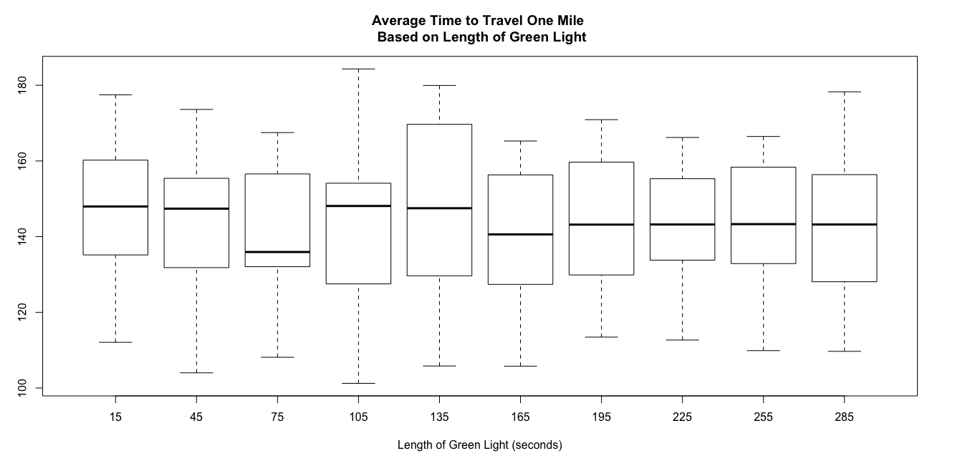
And the Results…
… are totally uninteresting
Varying the length of the light has no effect whatsoever on the average time spent in the simulation

Slide 8
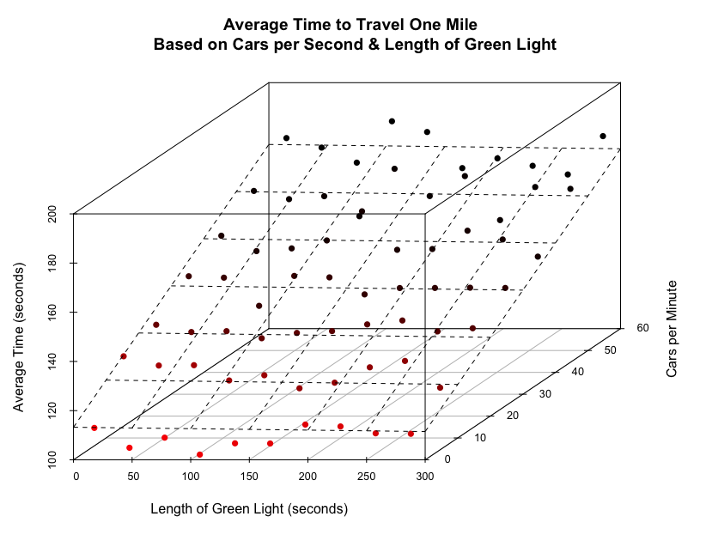
The Results (continued)

Slide 9
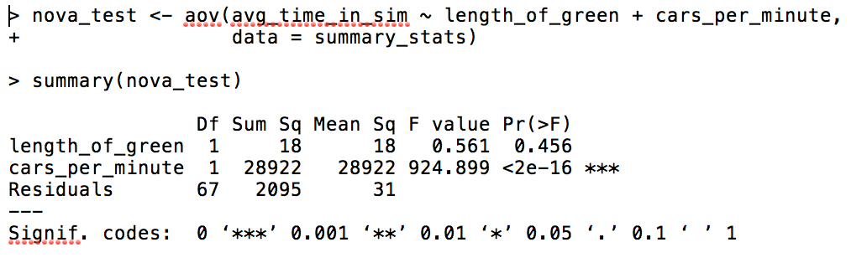
The Results (continued)

Slide 10
Why is this happening?
I’m really not sure… Is it...
… an error in my code?
… that perhaps I haven’t used big enough intervals?
… that it actually working properly? Perhaps…
The light has minimal impact on travel times overall
While one car may experience much longer times depending on the light timing strategy, the average time spent by ALL cars will not change

Slide 11
Potential Improvements
I am passing an entire data frame into multiple functions – this is probably slowing me down AND can be improved
More research to see if there is an error in my code or these results are valid
Other, smarter light strategies
Look at the ratios of cars in the competing queues to see which needs green more
More checks down range to anticipate cars coming
Combination strategies using timers and/or other sensors

Slide 12
Questions?

